Slide 1
Autism Spectrum Disorder (ASD)
Patrick Weatherford
DSC 530 – Data Exploration and Analysis

Slide 2
Introduction
“Autism spectrum disorder (ASD) is a developmental disability that can cause significant social, communication and behavioral challenges. People with ASD may communicate, interact, behave, and learn in ways that are different from most other people” (CDC). When diagnosing a patient 2 criteria are used to determine how severe the disorder is: 1) Social impairment, 2) Degree of restricted and/or repetitive behaviors. Based on these 2 criteria, the level of severity is determined and can range anywhere from low-functioning to high-functioning.
In the United States, the prevalence of ASD as of 2018 is estimated to be 23 per 1000 (2.3%). That equates to roughly 1 out of every 44 people. The prevalence has been steadily increasing over time as well. For example, in 2000 the prevalence was 0.7% and in 2011 the prevalence was 1.1%. The specific cause of ASD is unclear but there have been specific gene expressions and environmental risk factors that have been found to increase the risk of ASD prevalence. Also, there are no known cures for ASD but behavior intervention is often used for low-functioning patients in hopes that they become independent.
For this analysis, data exploration will be conducted on environmental risk factors aggregated by U.S. State and then analyzed using various statistical methods to determine if they are potential predictors of ASD prevalence. Potential predictors will then be further analyzed to determine if they are significant and indicate an effect and if so, how much of an effect exists.
Patrick Weatherford – DSC 530 Data Exploration & Analysis

Slide 3
Data Set and Feature Definitions
Below is an explanation of the features included in the Data Set:
Feature | Where Found | Description
ASD Prevalence | www.Childhealthdata.org | Children aged 3-17 for years 2019-2020. This would mean that the children were born anywhere from 2002-2017.
Estimated Vaccination Rate % | www.CDC.gov | Children born 2014-2017. The estimated average vaccination rate for the below vaccines was averaged to obtain the overall average. Combined 7 Series DTaP (>= 3 Doses) Hep A (>= 1 Dose) Hep B (>= 1 Dose, 3 Day (Birth Dose)) Hib (Full Series) Influenza MMR (>= 1 Dose) PCV (>= 3 Doses) Polio Rotavirus Varicella (>= 1 Dose)
Father Age >= 40 Rate | www.CDC.gov | BRFSS birth natality data for year 2016. Tracks the rate of births where the father’s documented age was greater than or equal to 40 years of age when the birth occurred.
Mother Age >= 40 Rate | www.CDC.gov | BRFSS birth natality data for year 2016. Tracks the rate of births where the mother’s documented age was greater than or equal to 40 years of age when the birth occurred.
Premature Birth Rate | www.CDC.gov | BRFSS birth natality data for year 2016. Tracks the rate of births where the baby was born before 37 weeks of the pregnancy term.
U.S. Population | www.census.gov | U.S. population data for year 2020.
Obesity Rate | www.CDC.gov | BRFSS morbidity data for year 2015. The prevalence of obesity in the U.S. A person is considered obese if their Body Mass Index (BMI) is greater than or equal to 30.
Bing Drinking Rate | www.CDC.gov | BRFSS morbidity data for year 2015. Prevalence of binge drinking in the U.S. This is defined as having 5 or more drinks in a day per week for men and 4 or more drinks in a day per week for women.
Patrick Weatherford – DSC 530 Data Exploration & Analysis

Slide 4
Data Set Example
Below is a sample of the data set.
State | Total Births | Father Age >= 40 Rate | Mother Age >= 40 Rate | Premature Births | Premature Birth Rate | Currently has condition % | Population | Vaccination Rate Estimation % | ObesityRate | Binge_Drinking_%
Alabama | 59151 | 6.74 | 1.62 | 7083 | 11.97 | 3.1 | 5024279 | 82.16363636 | 35.6 | 12.2
Alaska | 11209 | 8.68 | 2.18 | 999 | 8.91 | 3.2 | 733391 | 77.16363636 | 29.8 | 20
Arizona | 84520 | 8.92 | 2.66 | 7654 | 9.06 | 3.3 | 7151502 | 80.7 | 28.4 | 15
Arkansas | 38274 | 6.33 | 1.55 | 4157 | 10.86 | 2.5 | 3011524 | 80.36363636 | 34.5 | 15.2
California | 488827 | 13.22 | 4.46 | 42074 | 8.61 | 3 | 39538223 | 79.74545455 | 24.2 | 16.7
Colorado | 66613 | 10.38 | 3.29 | 5898 | 8.85 | 1.9 | 5773714 | 83.36363636 | 20.2 | 18.1
Connecticut | 36015 | 13.28 | 4.31 | 3375 | 9.37 | 3.3 | 3605944 | 86.7 | 25.3 | 18.3
Delaware | 10992 | 8.02 | 2.76 | 1105 | 10.05 | 4.4 | 989948 | 85.10909091 | 29.7 | 15.8
. . . | . . . | . . . | . . . | . . . | . . . | . . . | . . . | . . . | . . . | . . .
. . . | . . . | . . . | . . . | . . . | . . . | . . . | . . . | . . . | . . . | . . .
New Hampshire | 12267 | 10.42 | 2.62 | 954 | 7.78 | 4.3 | 1377529 | 85.44545455 | 26.3 | 17.8
New Jersey | 102647 | 14.23 | 4.57 | 10126 | 9.86 | 3.4 | 9288994 | 80.71818182 | 25.6 | 17
New Mexico | 24692 | 7.36 | 2.27 | 2464 | 9.98 | 3.1 | 2117522 | 81.9 | 28.8 | 13.6
New York | 234283 | 14.22 | 4.72 | 20956 | 8.94 | 2.1 | 20201249 | 80.73636364 | 25 | 17.6
North Carolina | 120779 | 9.03 | 2.7 | 12542 | 10.38 | 3.2 | 10439388 | 83.5 | 30.1 | 14.6
North Dakota | 11383 | 7.02 | 2.07 | 1040 | 9.14 | 1.9 | 779094 | 86.2 | 31 | 24.9
Ohio | 138085 | 7.53 | 2.13 | 14388 | 10.42 | 3 | 11799448 | 77.70909091 | 29.8 | 19.5
Oklahoma | 52592 | 6.99 | 1.72 | 5597 | 10.64 | 3.7 | 3959353 | 79.14545455 | 33.9 | 13.6
Oregon | 45535 | 10.41 | 3.42 | 3620 | 7.95 | 3.1 | 4237256 | 79.56363636 | 30.1 | 17.7
Pennsylvania | 139409 | 9.15 | 2.65 | 12962 | 9.3 | 3.5 | 13002700 | 84.47272727 | 30 | 18.5
Rhode Island | 10798 | 11.26 | 3.2 | 1008 | 9.34 | 3.3 | 1097379 | 87.98181818 | 26 | 17
South Carolina | 57342 | 7.78 | 2.21 | 6395 | 11.15 | 3.2 | 5118425 | 80.29090909 | 31.7 | 16.3
South Dakota | 12275 | 6.81 | 1.9 | 1098 | 8.95 | 2.4 | 886667 | 82.90909091 | 30.4 | 17.9
Tennessee | 80807 | 7.79 | 2.09 | 9085 | 11.24 | 2.4 | 6910840 | 79.67272727 | 33.8 | 10.9
Texas | 398047 | 9.05 | 2.71 | 41388 | 10.4 | 3.4 | 29145505 | 80.16363636 | 32.4 | 16.1
Utah | 50464 | 6.92 | 2.24 | 4851 | 9.61 | 1.8 | 3271616 | 82.45454545 | 24.5 | 11.4
Vermont | 5756 | 11.07 | 2.83 | 457 | 7.94 | 2.1 | 643077 | 83.38181818 | 25.1 | 19
Virginia | 102460 | 11.58 | 3.48 | 9792 | 9.56 | 3 | 8631393 | 85.43636364 | 29.2 | 17
Washington | 90505 | 10.43 | 3.34 | 7364 | 8.14 | 2.4 | 7705281 | 81.1 | 26.4 | 16.6
West Virginia | 19079 | 7.57 | 1.49 | 2259 | 11.84 | 2.5 | 1793716 | 79.57272727 | 35.6 | 11.8
Wisconsin | 66615 | 6.52 | 2.21 | 6385 | 9.58 | 4.3 | 5893718 | 83.22727273 | 30.7 | 24.4
Wyoming | 7386 | 7.07 | 1.99 | 700 | 9.48 | 2 | 576851 | 76.6 | 29 | 16.9
Patrick Weatherford – DSC 530 Data Exploration & Analysis

Slide 5
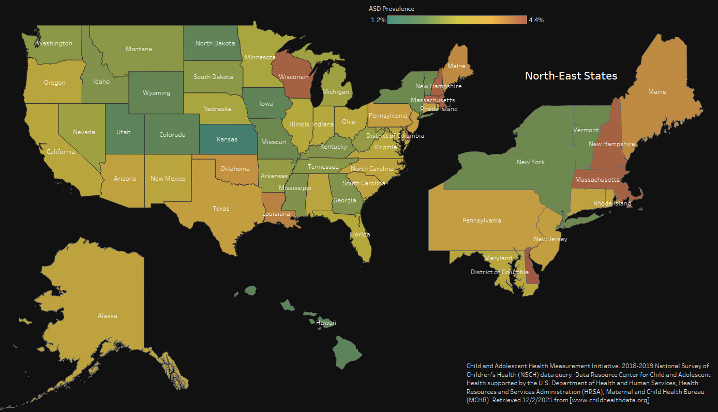
Feature Analysis – ASD Rate
Patrick Weatherford – DSC 530 Data Exploration & Analysis

Slide 6
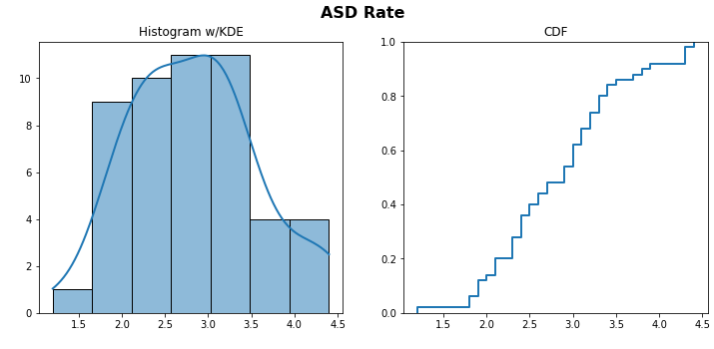
Feature Analysis – ASD Rate
Summary Statistics:
Mean: 2.83
Median: 2.9
Mode: 3.0
Variance: 0.53
Standard Deviation: 0.7
Skew: 0.29
Kurtosis: -0.32
Min: 1.2
Max: 4.4
Patrick Weatherford – DSC 530 Data Exploration & Analysis

Slide 7
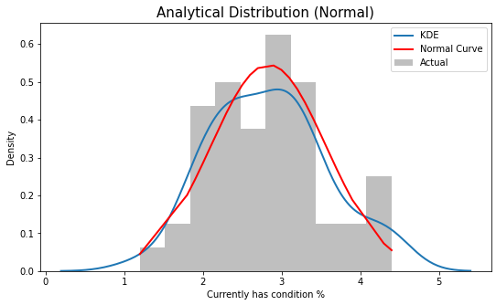
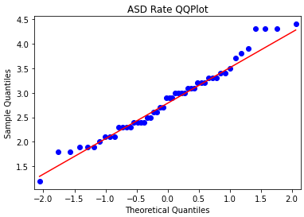
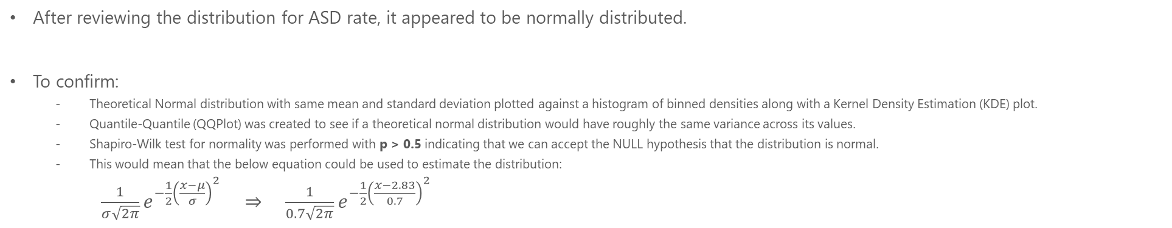
ASD Rate Density Estimation
After reviewing the distribution for ASD rate, it appeared to be normally distributed.
To confirm:
Theoretical Normal distribution with same mean and standard deviation plotted against a histogram of binned densities along with a Kernel Density Estimation (KDE) plot.
Quantile-Quantile (QQPlot) was created to see if a theoretical normal distribution would have roughly the same variance across its values.
Shapiro-Wilk test for normality was performed with p > 0.5 indicating that we can accept the NULL hypothesis that the distribution is normal.
This would mean that the below equation could be used to estimate the distribution:
$\frac{1}{σ\sqrt{2π}}e^{−\frac{1}{2}{\left(\frac{x−μ}{σ}\right)}^{2}} ⇒ \frac{1}{0.7\sqrt{2π}}e^{−\frac{1}{2}{\left(\frac{x−2.83}{0.7}\right)}^{2}}$
Patrick Weatherford – DSC 530 Data Exploration & Analysis

Slide 8
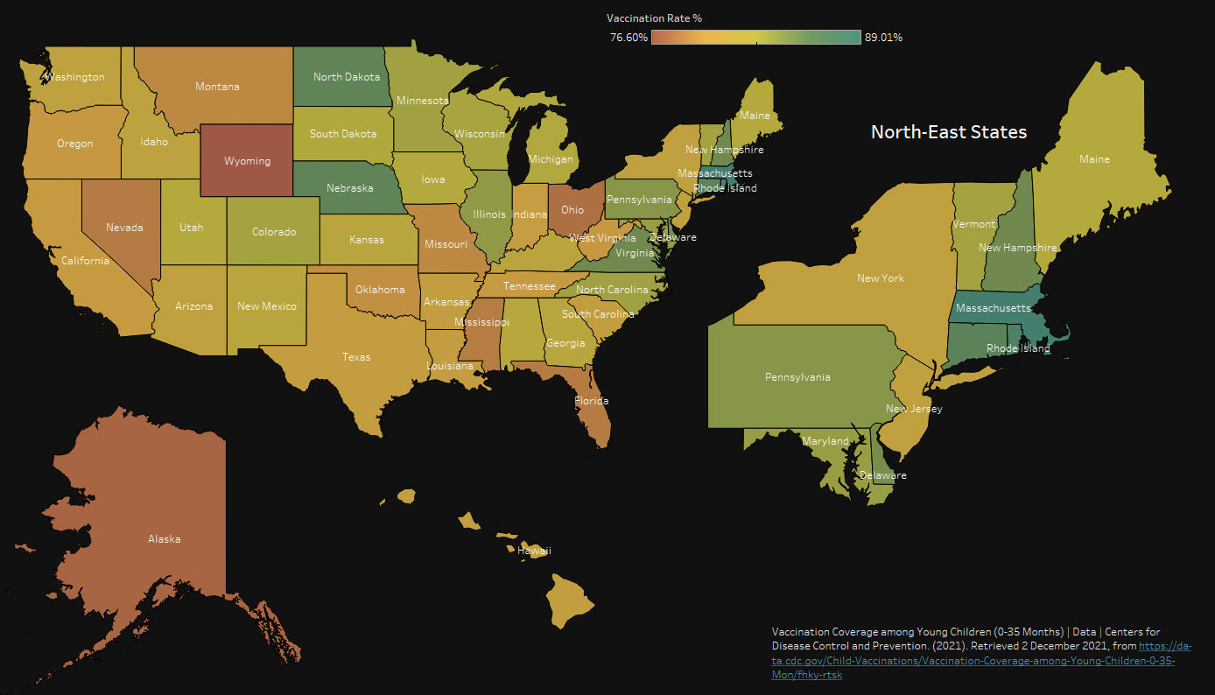
Feature Analysis – Avg. Vaccination Rate
Patrick Weatherford – DSC 530 Data Exploration & Analysis

Slide 9
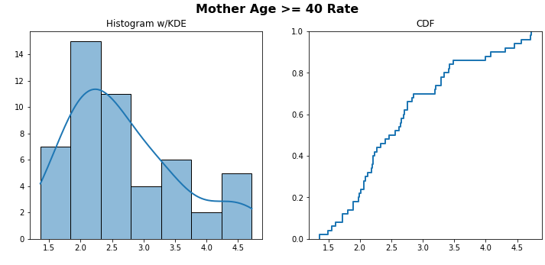
Feature Analysis – Avg. Vaccination Rate
Summary Statistics:
Mean: 2.69
Median: 2.51
Mode: 3.29
Variance: 0.79
Standard Deviation: 0.89
Skew: 0.81
Kurtosis: -0.18
Min: 1.36
Max: 4.72
Patrick Weatherford – DSC 530 Data Exploration & Analysis

Slide 10
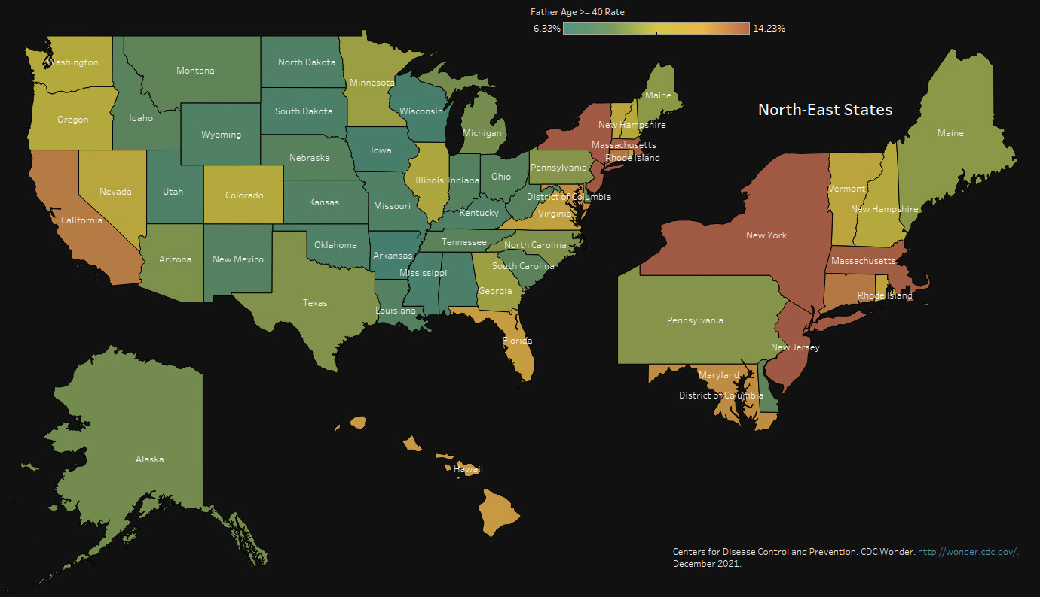
Feature Analysis – Father Age >= 40 Rate

Slide 11
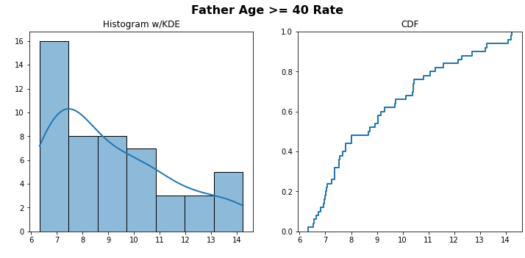
Feature Analysis – Father Age >= 40 Rate
Summary Statistics:
Mean: 9.16
Median: 8.71
Mode: 7.36
Variance: 5.36
Standard Deviation: 2.32
Skew: 0.76
Kurtosis: -0.56
Min: 6.33
Max: 14.23
Patrick Weatherford – DSC 530 Data Exploration & Analysis

Slide 12
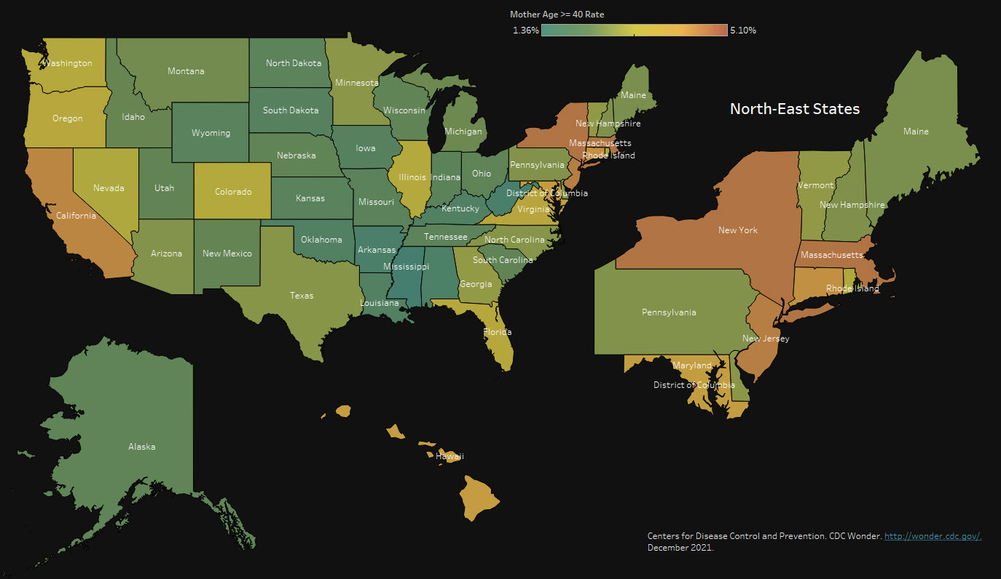
Feature Analysis – Mother Age >= 40 Rate
Patrick Weatherford – DSC 530 Data Exploration & Analysis

Slide 13
Feature Analysis – Mother Age >= 40 Rate
Summary Statistics:
Mean: 2.83
Median: 2.9
Mode: 3.0
Variance: 0.53
Standard Deviation: 0.7
Skew: 0.29
Kurtosis: -0.32
Min: 1.2
Max: 4.4
Patrick Weatherford – DSC 530 Data Exploration & Analysis

Slide 14
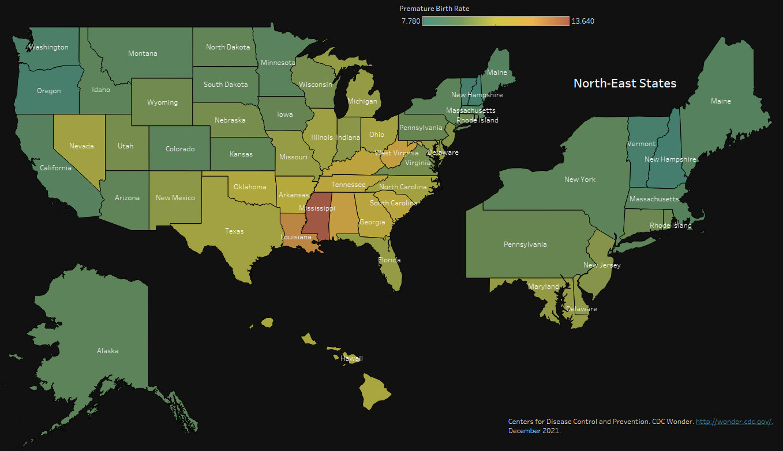
Feature Analysis – Premature Birth Rate
Patrick Weatherford – DSC 530 Data Exploration & Analysis

Slide 15
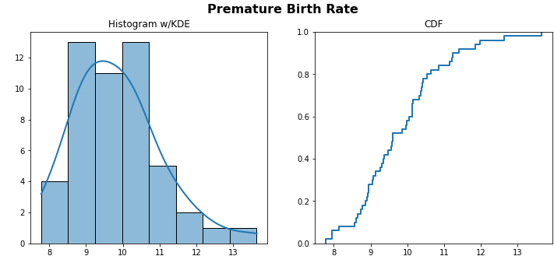
Feature Analysis – Premature Birth Rate
Summary Statistics:
Mean: 9.83
Median: 9.61
Mode: 10.14
Variance: 1.46
Standard Deviation: 1.21
Skew: 0.81
Kurtosis: 0.85
Min: 7.78
Max: 13.64
Patrick Weatherford – DSC 530 Data Exploration & Analysis

Slide 16
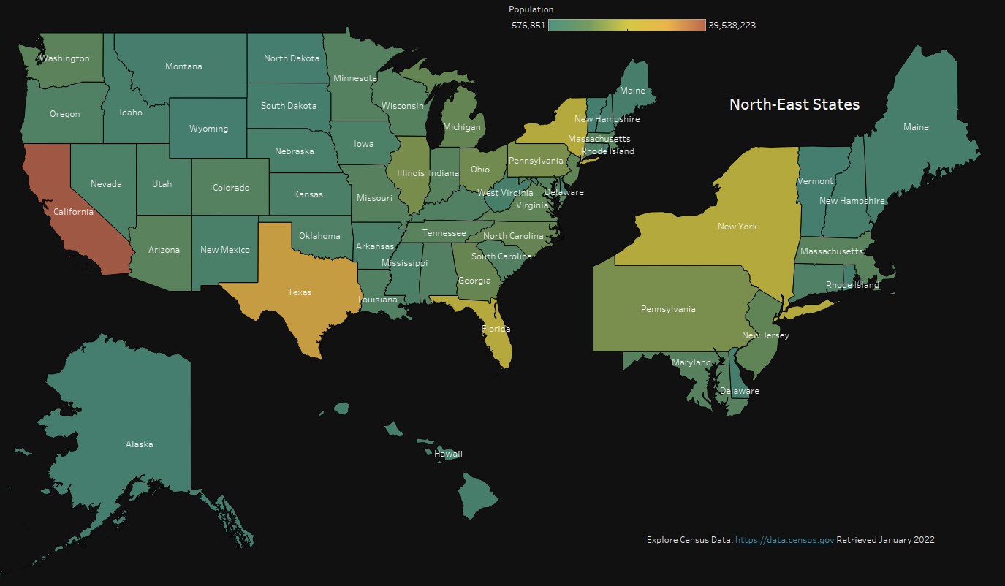
Feature Analysis – U.S. Population
Patrick Weatherford – DSC 530 Data Exploration & Analysis

Slide 17
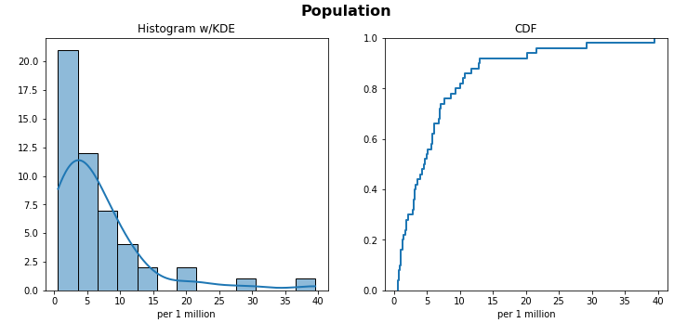
Feature Analysis – U.S. Population
Summary Statistics (*in millions):
Mean: 6.62
Median: 4.58
Mode: 5.02
Variance: 55.3
Standard Deviation: 7.44
Skew: 2.56
Kurtosis: 7.45
Min: 0.58
Max: 39.54
Patrick Weatherford – DSC 530 Data Exploration & Analysis

Slide 18
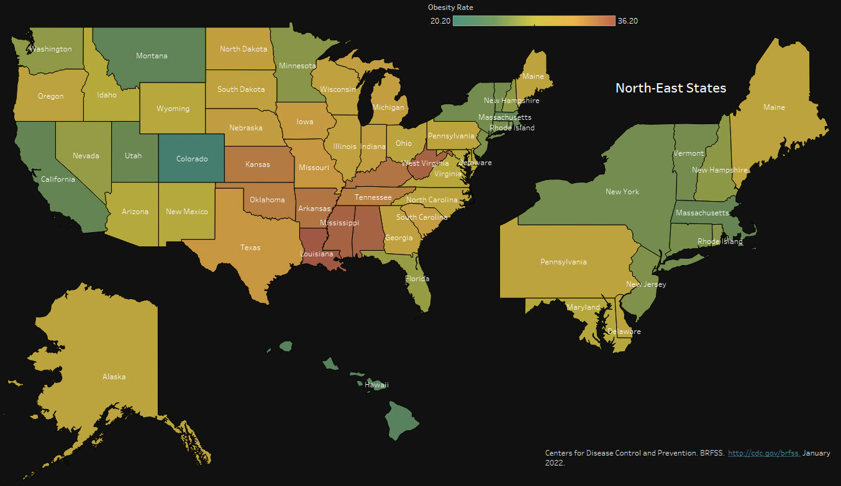
Feature Analysis – Obesity Rate
Patrick Weatherford – DSC 530 Data Exploration & Analysis

Slide 19
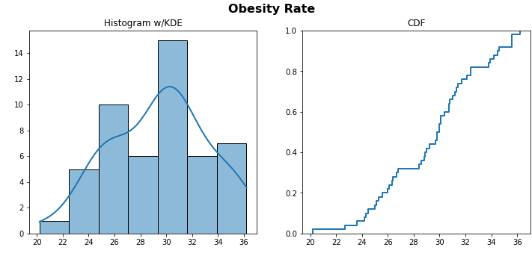
Feature Analysis – Obesity Rate
Summary Statistics:
Mean: 2.83
Median: 2.9
Mode: 3.0
Variance: 0.53
Standard Deviation: 0.7
Skew: 0.29
Kurtosis: -0.32
Min: 1.2
Max: 4.4
Patrick Weatherford – DSC 530 Data Exploration & Analysis

Slide 20
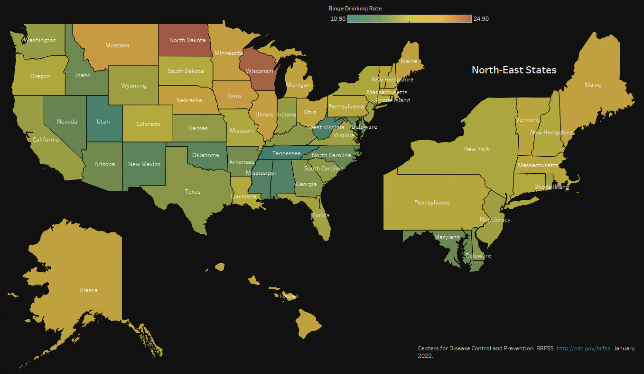
Feature Analysis – Binge Drinking Rate
Patrick Weatherford – DSC 530 Data Exploration & Analysis

Slide 21
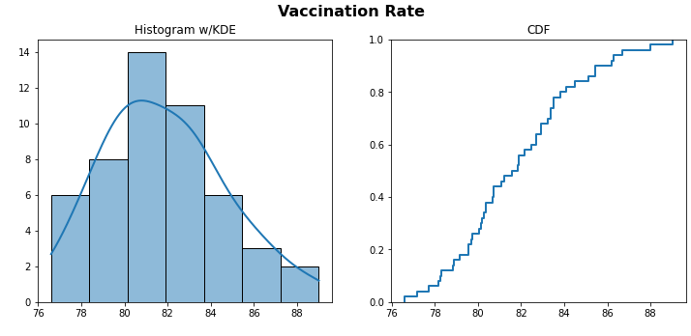
Feature Analysis – Binge Drinking Rate
Summary Statistics:
Mean: 81.84
Median: 81.7
Mode: 82.7
Variance: 7.8
Standard Deviation: 2.82
Skew: 0.43
Kurtosis: -0.27
Min: 76.6
Max: 89.0
Patrick Weatherford – DSC 530 Data Exploration & Analysis

Slide 22
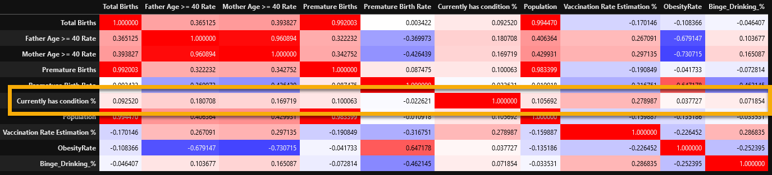
Correlation Matrix
Based on the correlation matrix above, the below features have the strongest correlation with ASD prevalence.
Vaccination Rate: 0.28
Father Age >= 40 Rate: 0.18
Mother Age >= 40 Rate: 0.17
Because the Father Age & Mother Age variables are covary, I will exclude Mother Age from the analysis because it has slightly less correlation with ASD.
Patrick Weatherford – DSC 530 Data Exploration & Analysis

Slide 23
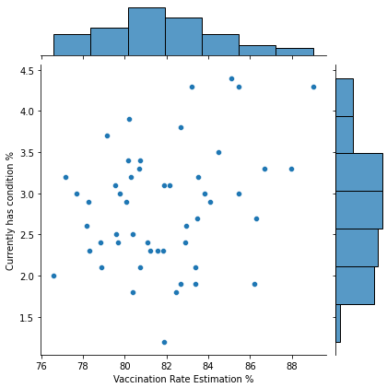
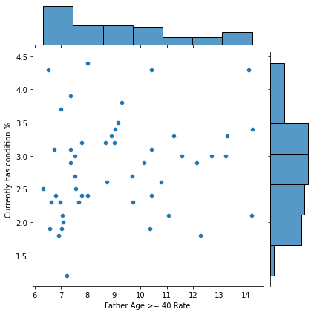
Scatter Plots of Selected Features
Patrick Weatherford – DSC 530 Data Exploration & Analysis

Slide 24
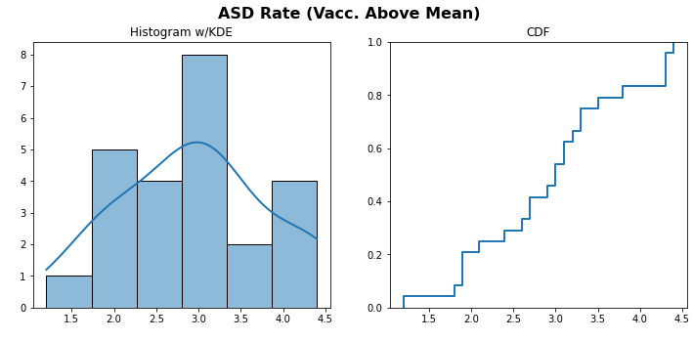
Scenario 1 – ASD when Vaccination Rate Above Mean
Summary Statistics:
Mean: 2.95
Median: 3.0
Mode: 1.9
Variance: 0.78
Standard Deviation: 0.88
Skew: 0.02
Kurtosis: -0.72
Min: 1.2
Max: 4.4
Patrick Weatherford – DSC 530 Data Exploration & Analysis

Slide 25
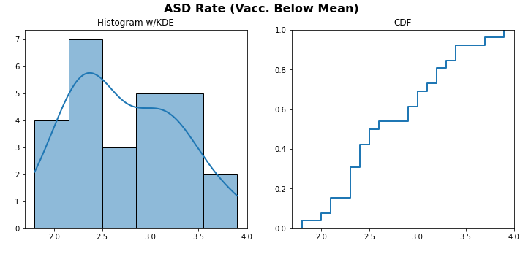
Scenario 2 – ASD when Vaccination Rate Below Mean
Summary Statistics:
Mean: 2.73
Median: 2.55
Mode: 2.3
Variance: 0.31
Standard Deviation: 0.55
Skew: 0.35
Kurtosis: -0.84
Min: 1.8
Max: 3.9
Patrick Weatherford – DSC 530 Data Exploration & Analysis

Slide 26
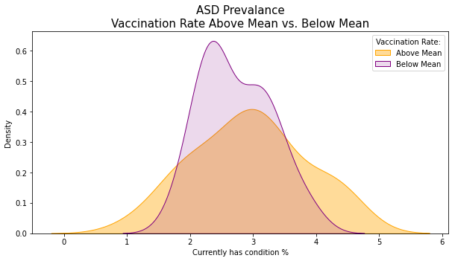
ASD - Vaccination Rate Above vs. Below Mean
ASD rate seems to be unaffected by the Vaccination Rate. This was confirmed using ANOVA testing which had a p-value of 0.304 which allows us to accept the NULL hypothesis that the means between the groups are the same.
The variance however seems to be affected by Vaccination Rate. For observations below the vaccination rate mean the variance is less. This gives the impression that as vaccination rates decrease, the more likely it is that the ASD rate will be the mean value. Vice-versa, as vaccination rates increase, the more unpredictable the ASD rate will be.
Patrick Weatherford – DSC 530 Data Exploration & Analysis

Slide 27
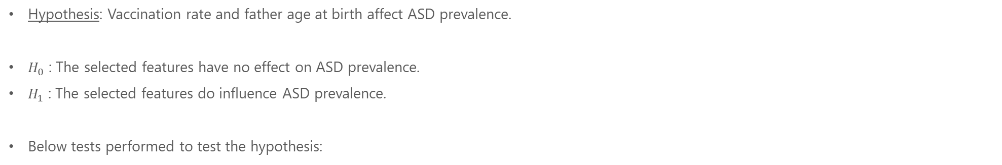
Hypothesis Testing
Hypothesis: Vaccination rate and father age at birth affect ASD prevalence.
$H_{0}$ : The selected features have no effect on ASD prevalence.
$H_{1}$ : The selected features do influence ASD prevalence.
Below tests performed to test the hypothesis:
Test | Variables | p-value
1-way ANOVA | ASD vs. Vaccination Rate | < 0.000
 | ASD vs. Father Age >= 40 Rate | < 0.000
Student’s t-test | ASD vs. Vaccination Rate | < 0.000
 | ASD vs. Father Age >= 40 Rate | < 0.000
Mann-Whitney U Test | ASD vs. Vaccination Rate | < 0.000
 | ASD vs. Father Age >= 40 Rate | < 0.000
Result:
Both selected features are significant which allows us to accept the alternative $H_{1}$ hypothesis that the features do have an effect on ASD prevalence
Patrick Weatherford – DSC 530 Data Exploration & Analysis

Slide 28
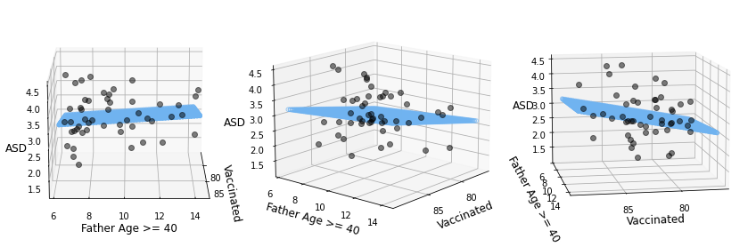
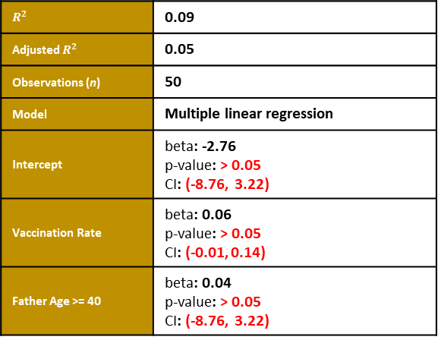
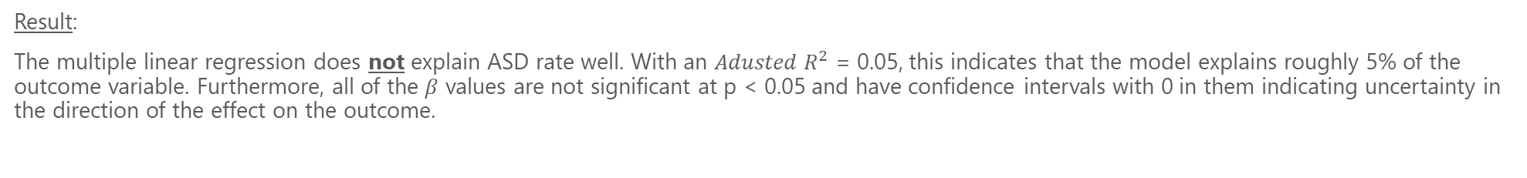
Regression Analysis
$R^{2}$ | 0.09
Adjusted $R^{2}$ | 0.05
Observations (n) | 50
Model | Multiple linear regression
Intercept | beta: -2.76 p-value: > 0.05 CI: (-8.76, 3.22)
Vaccination Rate | beta: 0.06 p-value: > 0.05 CI: (-0.01, 0.14)
Father Age >= 40 | beta: 0.04 p-value: > 0.05 CI: (-8.76, 3.22)
Result:
The multiple linear regression does not explain ASD rate well. With an $Adusted R^{2}$ = 0.05, this indicates that the model explains roughly 5% of the outcome variable. Furthermore, all of the $β$ values are not significant at p < 0.05 and have confidence intervals with 0 in them indicating uncertainty in the direction of the effect on the outcome.
Patrick Weatherford – DSC 530 Data Exploration & Analysis

Slide 29
References
Basics About Autism Spectrum Disorder (ASD) | NCBDDD | CDC. (2020, August 11). Retrieved from https://www.cdc.gov/ncbddd/autism/facts.html
Child and Adolescent Health Measurement Initiative. 2018-2019 National Survey of Children’s Health (NSCH) data query. Data Resource Center for Child and Adolescent Health supported by the U.S. Department of Health and Human Services, Health Resources and Services Administration (HRSA), Maternal and Child Health Bureau (MCHB). Retrieved 12/2/2021 from www.childhealthdata.org
Explore Census Data. (2021). Retrieved 2 December 2021, from https://data.census.gov/cedsci/
Vaccination Coverage among Young Children (0-35 Months) | Data | Centers for Disease Control and Prevention. (2021). Retrieved 2 December 2021, from https://data.cdc.gov/Child-Vaccinations/Vaccination-Coverage-among-Young-Children-0-35-Mon/fhky-rtsk
Centers for Disease Control and Prevention. CDC Wonder. http://wonder.cdc.gov/. December 2021.
CDC BRFSS. (2022). Retrieved 17 January 2022, from https://www.cdc.gov/brfss/
CDC BRFSS. (2022). Retrieved 20 January 2022, from https://www.cdc.gov/brfss/
Patrick Weatherford – DSC 530 Data Exploration & Analysis

